Slide 1
Predicting Problematic Internet Use
Notes:
The goal of our project is to

Slide 2
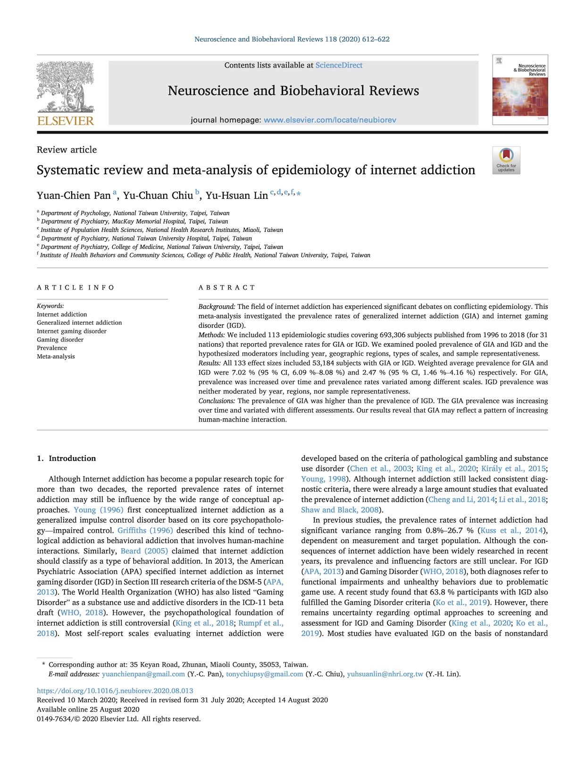


The Problem
Notes:
Researchers [click]
have identified internet use as having the potential to rise to the level of addiction, and [click]
problematic internet use is associated with increased rates of anxiety and depression. However, currently, identifying problematic internet usage requires complex, expert evaluation, which limits our ability to identify it [click]
In contrast [click]

Slide 3

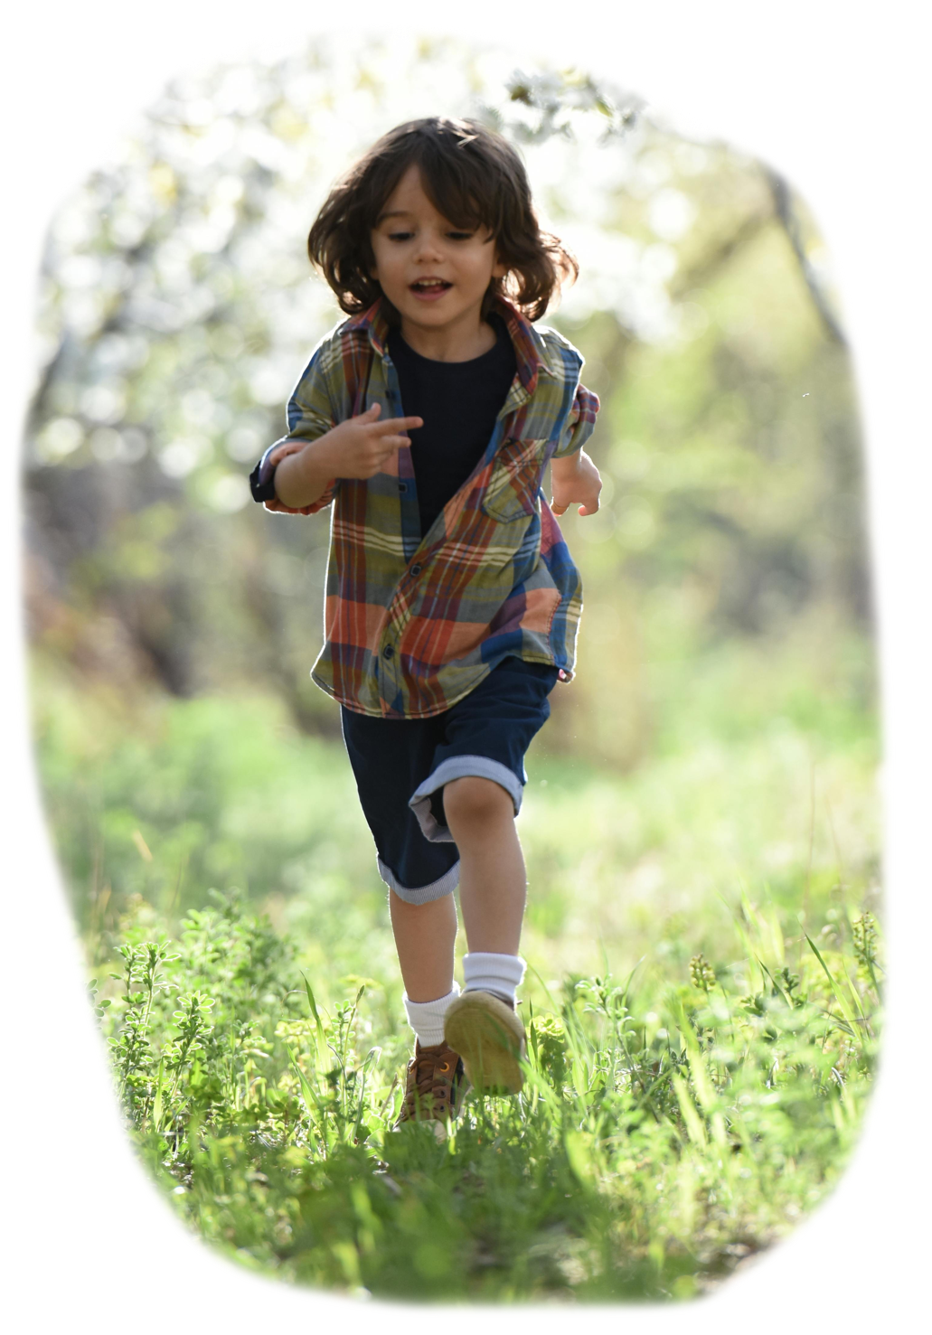

The Goal
Identify early signs of problematic internet use based on physical activity and fitness data.
Notes:
It is relatively straightforward to [click]
administer simple surveys and [click]
measure children’s activity level. Thus, the goal of our project is to [click]
Identify early signs of problematic internet use based on physical activity and fitness data. This project came to us by way of Kaggle, which is a data science competition platform. This particular research question [click]
was posed by the Child-Mind Institute, which supports children and families who are struggling with mental health [click]

Slide 4
5,000 children
Ages 5 through 22
HEALTHY BRAIN NETWORK
The Data
Notes:
The data for the competition comes from the Institute’s healthy brain network study. Participants in the study included [click] about five-thousand 5-22 year-olds, although we only had access to data from approximately 3500 of these participants. [click]

Slide 5
Parent-Child Internet Addiction Test (PCIAT)
0
1
2
3
None
Severe
Severity Impairment Index (SII)
~3960 participants
~3000 with at least some target information.
The Data: Target Variable
Notes:
The target variable is [click]
the severity impairment index, or sii. Participants completed [click]
A 20-question parent-child internet addiction test, or PCIAT. [click]
The total scores were binned into four levels, ranging from 0, or no impairment, to 3, or severe impairment. [click]
Of the 3960 participants [click]
Approximately 3,000 had reported scores for at least some of the PCIAT questions [click]

Slide 6

Demographics
Age
Sex
Physical
Height
Weight
BMI
Waist
Systolic BP
Diastolic BP
Heart Rate
The Data: Predictor Variables
Notes:
We were given a total of 33 predictor variable, spanning a variety of measurements. The variables naturally fall into several groupings. [click]
Basic demographics [click]
And basic physical measurements like height and weight. [click]

Slide 7
Demographics
Age
Sex
Internet Use
Hours per Day
Physical
Height
Weight
BMI
Waist
Systolic BP
Diastolic BP
Heart Rate
Children's Global Assessment Scale
Sleep Disturbance Scale
Physical Activity Questionnaire
PAQ MVPA Zone
The Data: Predictor Variables
Notes:
Then there was data from several surveys [click]
Including reported internet use [click]
A Children’s Global Assessment Scale [click]
A Sleep Disturbance Scale [click]
And a physical activity questionnaire. [click]
A review of the research suggested cutoffs we used to compute whether participants had reached a threshold of physical activity. [click]

Slide 8
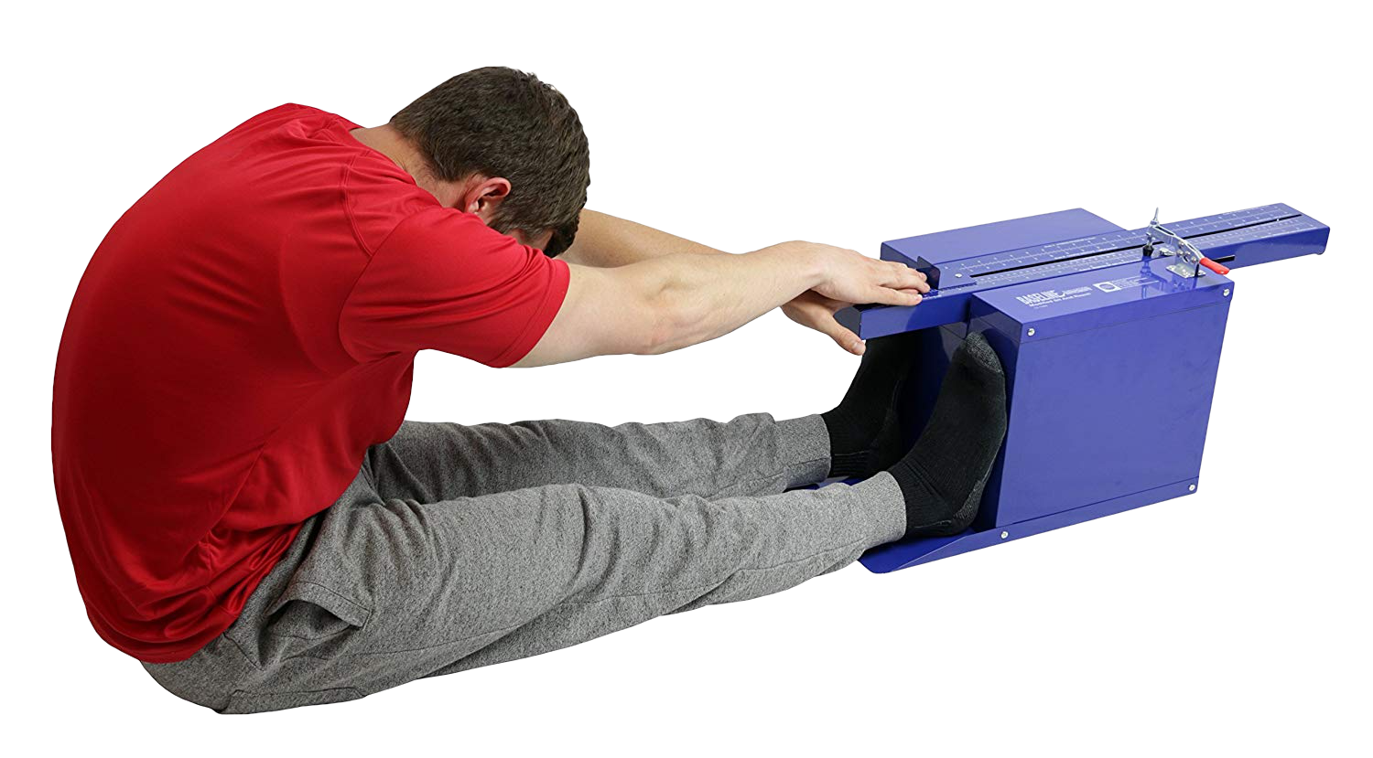
Demographics
Age
Sex
Internet Use
Hours per Day
Fitness
Endurance Time
Endurance Max
Curl-Up
Grip Strength D
Grip Strength ND
Push-Up
Sit & Reach Left
Sit & Reach Right
Trunk Lift
Physical
Height
Weight
BMI
Waist
Systolic BP
Diastolic BP
Heart Rate
Children's Global Assessment Scale
Sleep Disturbance Scale
Physical Activity Questionnaire
Fitness Zone
Curl-Up
Grip Strength D
Grip Strength ND
Push-Up
Sit & Reach Left
Sit & Reach Right
Trunk Lift
PAQ MVPA Zone
The Data: Predictor Variables
Notes:
There were results from a fitness test similar to the Presidential Fitness Test [click]
that some of you may have completed in grade school, [click]
We found reference values that allowed us to compute whether each of these measurements was in a target zone. [click]

Slide 9
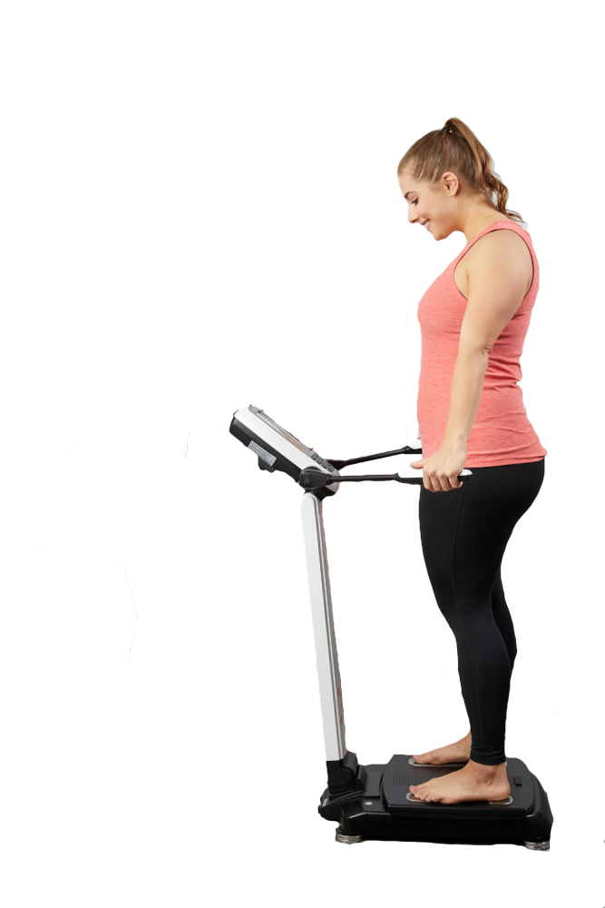
Demographics
Age
Sex
Internet Use
Hours per Day
Fitness
Endurance Time
Endurance Max
Curl-Up
Grip Strength D
Grip Strength ND
Push-Up
Sit & Reach Left
Sit & Reach Right
Trunk Lift
BIA
Bone Mineral Content
BMI
Basal Metabolic Rate
Daily Energy Exp.
Extracellular Water
Fat Free Mass
FFM Index
Fat Mass Index
Body Fat Percentage
Body Frame
Intracellular Water
Lean Dry Mass
Lean Soft Tissue
Skeletal Muscle Mass
Total Body Water
Physical
Height
Weight
BMI
Waist
Systolic BP
Diastolic BP
Heart Rate
Children's Global Assessment Scale
Sleep Disturbance Scale
Physical Activity Questionnaire
Fitness Zone
Curl-Up
Grip Strength D
Grip Strength ND
Push-Up
Sit & Reach Left
Sit & Reach Right
Trunk Lift
PAQ MVPA Zone
The Data: Predictor Variables
Notes:
Other predictors came from measurements of bio-electric impedance [click]
Including things like bone mineral content and total body water. [click]

Slide 10
Demographics
Age
Sex
Internet Use
Hours per Day
Fitness
Endurance Time
Endurance Max
Curl-Up
Grip Strength D
Grip Strength ND
Push-Up
Sit & Reach Left
Sit & Reach Right
Trunk Lift
BIA
Bone Mineral Content
BMI
Basal Metabolic Rate
Daily Energy Exp.
Extracellular Water
Fat Free Mass
FFM Index
Fat Mass Index
Body Fat Percentage
Body Frame
Intracellular Water
Lean Dry Mass
Lean Soft Tissue
Skeletal Muscle Mass
Total Body Water
Physical
Height
Weight
BMI
Waist
Systolic BP
Diastolic BP
Heart Rate
Children's Global Assessment Scale
Sleep Disturbance Scale
Physical Activity Questionnaire
Fitness Zone
Curl-Up
Grip Strength D
Grip Strength ND
Push-Up
Sit & Reach Left
Sit & Reach Right
Trunk Lift
PAQ MVPA Zone
The Data: Predictor Variables
Notes:
For each variable we reviewed references in the literature to identify and eliminate problematic values [click]

Slide 11
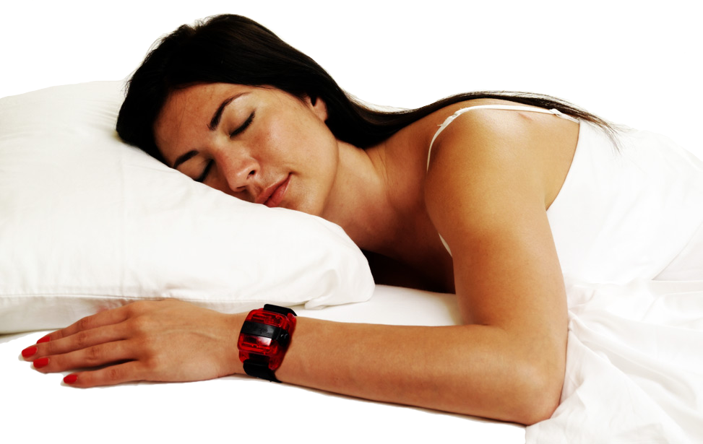
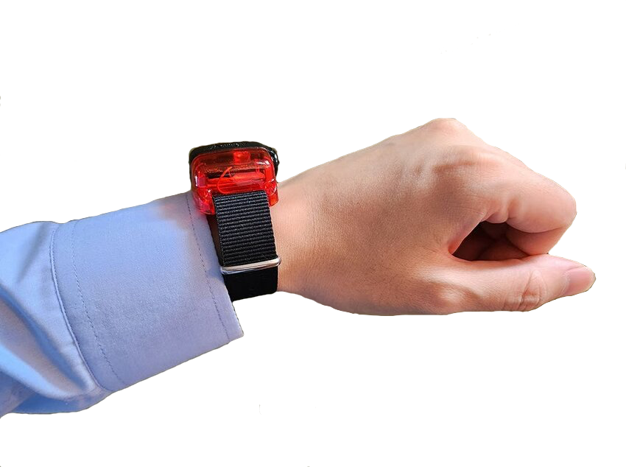


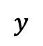

Continuous recording of accelerometer data for a single subject spanning many days.
$$z$$
$$x$$
$$θ$$
$$y$$
ENMO
5-minute
The Data: Actigraphy
Notes:
Approximately 1000 participants were given a wrist-worn accelerometer [click]
Which reported acceleration in three dimensions [click]
And angle from horizontal. [click]
We computed Euclidean Norm Minus One values [click]
Then grouped the data into 5-minute bouts to compute means [click]
Identified whether each mean was above thresholds we identified from actigraphy research
We also had accelerometer data: some of the participants wore an accelerometer wristwatch for roughly one month; and we had accelerometer data on 5-second intervals for those participants.
[discuss sample size]
(CLICK) At least some data was provided for approximately 3800 participants, although as we’ll discuss later, a large number of participants had to be eliminated because of missing data.

Slide 12
Data Challenges
Constraints of Contest
No team members with substantial domain knowledge
No contact with “primary client” (Child-Mind Institute)
Accelerometer data
Time series data->Need to convert to one or more summary variables measuring activity
Data provided is 5-second averages->standard summary variables were not applicable.
Other data issues
Missing data
Inconsistencies in the data
Notes:
We wanted to start by discussing some of the more interesting challenges we faced in our initial work on the data, before we got to the business of constructing and evaluating models.
(CLICK) (SKIP THIS SECTION?) We opted to work on the Kaggle competition project because we were interested in the topic, but also because we also thought the competition set-up might provide a more streamlined scenario to work in. But we also found the competition set-up brought up its own issues. (CLICK) In particular, the data set was predetermined, so we had no control of what the data was and none of the team members had any expertise relevant to the dataset. Also, we had no contact with the primary client, the Child-Mind Institute, to discuss the data or research question in any way. Although these are not problems unique to a competition setting, the setting may have exacerbated them.
(CLICK) One aspect of the data that we initially found very intriguing and promising was the accelerometer data, collected over roughly 1 month from about 1000 of the participants. (CLICK) The data provided was time-series data. To make it useful, we needed to develop one of more variables that would summarize activity for each participants. (CLICK) One limitation we faced was that were weren’t provided the raw accelerometer data, but rather 5-second running averages. Although there are some standardized ways of doing this, these methods weren’t directly applicable to the form out data took. We ultimately developed two custom variables based on a literature review.
(CLICK)
There was also considerable missing data. Almost 1000 participants did not complete any of the Parent-Child Internet Addiction Survey, so there was no information on the target variable; these cases were dropped. Other participants did not answer some of the survey questions, leading to potential inaccuracies in the SII score. Among the 3000 cases with SII scores, every case was missing data for at least one variable.
There were some other issues with the data itself. (SAY SOMETHING here about grip strength? The way they computed SII score?)

Slide 13
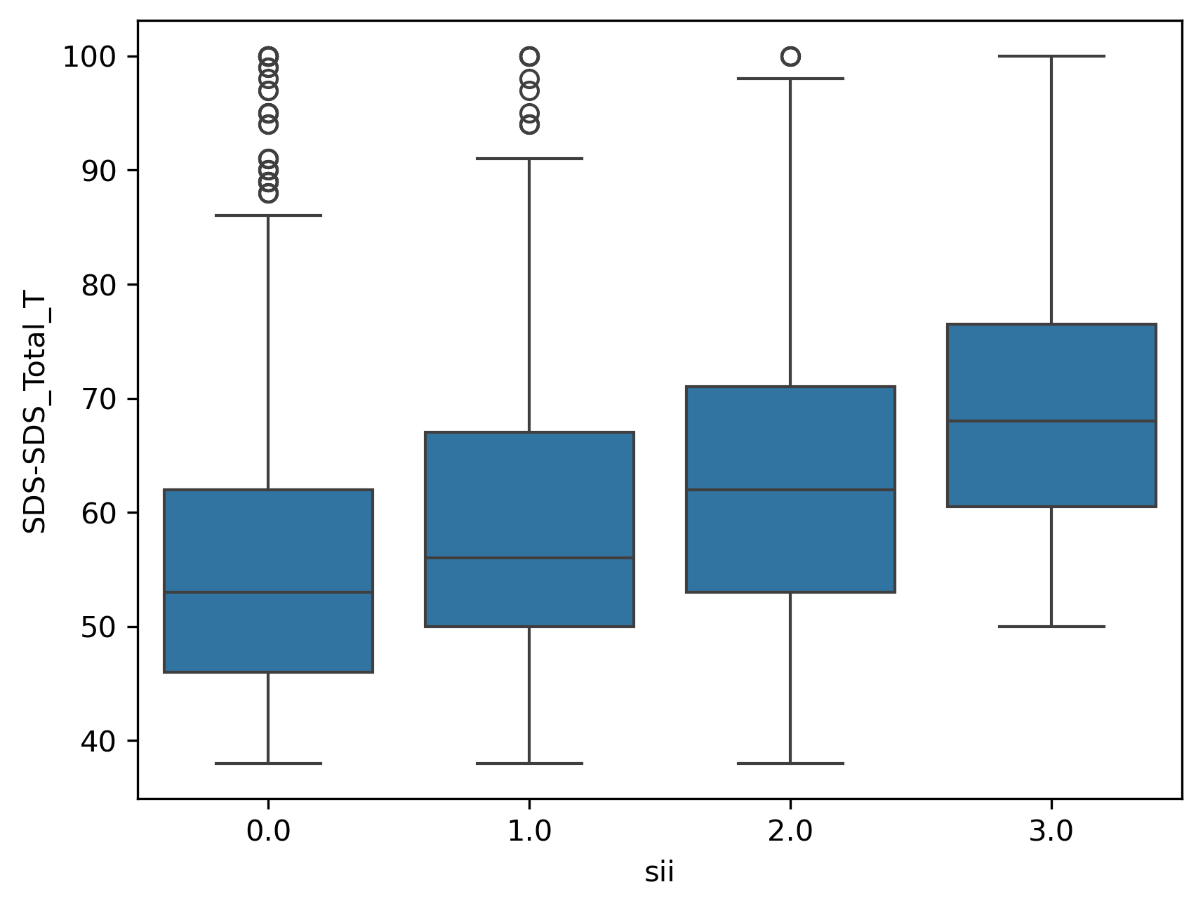
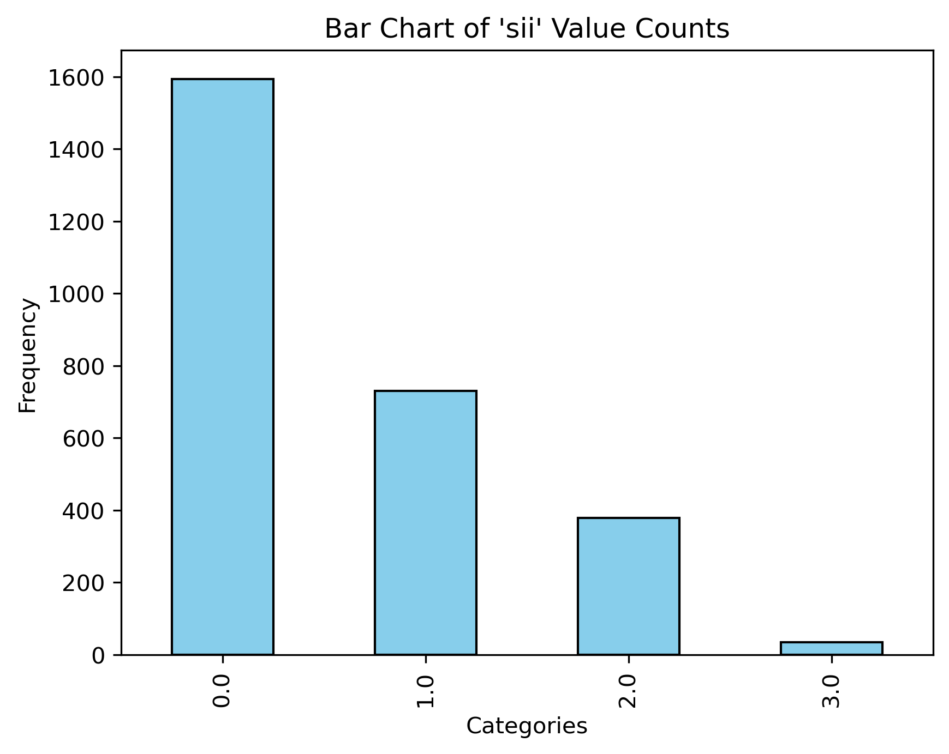
Data Challenges
No predictor variables showed much predictive power.
Sparse data for SII score 3.
Notes:
The previous issues I mentioned were more situational, but there were also some important challenges intrinsic to the data itself.
(CLICK)
In our exploratory data analysis, we saw no strong relationships between any of the predictor variables and SII, suggesting that it may simply be difficult to predict problematic internet usage based on physical activity.
(CLICK)
Additionally, the distribution of participants across SII scores was very uneven. In particular, there were only XX participants who were measured with an SII score of 3, or severe, in the entire data set; and a very high rate of 0’s. Because of this, our models generally had a very hard time predicting 3’s.

Slide 14
Modeling Process
Contest-specified evaluation: Cohen’s Kappa with quadratic weights
Measure of accuracy for ordinal variables
Imputation of missing values
KNN imputation of missing PCIAT question responses, for improved PCIAT total score/SII score.
Custom imputation for predictor variables:
Performance comparison of KNN vs. MICE
follow-up encoding of derived “zone” variables.
Duplicate data to inflate # of SII 3’s.
Multiple options for prediction
Predict SII directly, as quantitative variable
Predict PCIAT and compute SII
Option to tweak SII bin cut-offs.
Ordinal classifier for SII
Notes:
Some of these issues we attempted to address prior to modeling and some as part of the modeling process. Here we wanted to share some of the interesting aspects of our modeling work.
(CLICK) The competition evaluates submissions using Cohen’s Kappa, (CLICK) which is a measure of accuracy for ordinal variables. We couldn’t directly incorporate this into our model training as the loss function, but we did use this to compare models.
(CLICK) Because there was so much missing data, we needed to use imputation, rather than just remove cases with missing values.
(CLICK) Recall that the PCIAT questionnaire is the basis for the SII score, our ultimate target variable. We eliminated all cases that had no PCIAT data, and then imputed any remaining missing data for individual PCIAT questions. All questions were scored on the same scale, so we used KNN imputation here.
(CLICK) For the predictor variables, we tested both KNN and a MICE imputation. Some of the variables, various fitness zones, were derived from the fitness test quantitative measurements. Rather than imputing the zone values, we computed these separately after running the imputation.
(CLICK) To address the low number of severe, or 3 values, for the target variable SII, we also tested models where we duplicated cases with SII scores of 3 in our training data, and we ultimately found that this increased the effectiveness of our models.
(CLICK) Lastly, we had a choice of exactly what we would use as our target variable. Recall that SII is an ordinal variable, derived from the PCIAT score, a quantitative variable. (CLICK) One option would be to predict SII directly, treating it as essentially a quantitative variable. (CLICK) Another option was to predict PCIAT scores and then compute SII based on it. In this scenario, we found that our models seemed to underpredict SII. In fact, we could not build a model that would predict any 3’s, the highest SII score. To try to address this, we also played with different cut points for translating PCIAT score to SII. (CLICK) The last option we saw was to try to predict SII using classification. However, we didn’t want to lose the fact that SII is an ordinal variable. So rather than using straight classification, we identified some strategies for an ordinal classifier.

Slide 15
Final Results
Say something here about the models that rose to the top and the performance of those models.

